Slide 1
Online Movie Review System
Filip STOYANOV, 2022

Slide 2
USER ROLES
Anonymous users – can view the information pages (About, Terms of use) and view information about movies in the system(trailers, comments and etc.)
Registered users - add, edit and delete friends; add, edit and delete movie; create collections
Administrators - can delete users and movies

Slide 3
FUNCTIONALITIES
1. Viewing static pages – About, Terms of use
2. Provides ability for registration
3. Search Movie - watching trailer, reading comments and etc.
4. For registered users provides ability for adding new movies, creating collection, chatting with friends and rating your friends’ collections

Slide 4
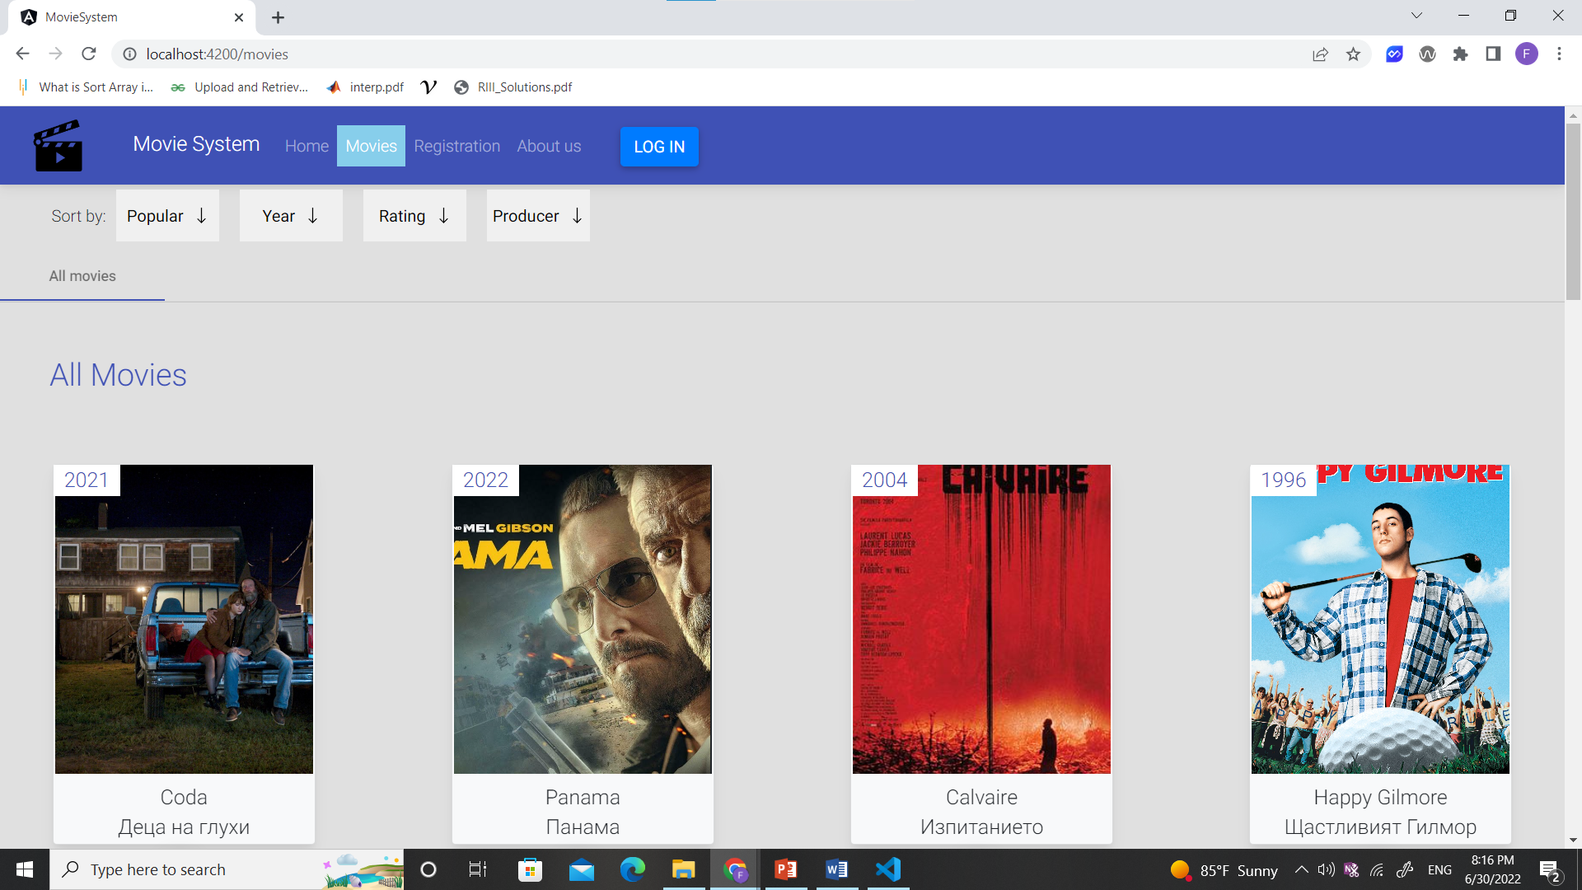

Slide 5
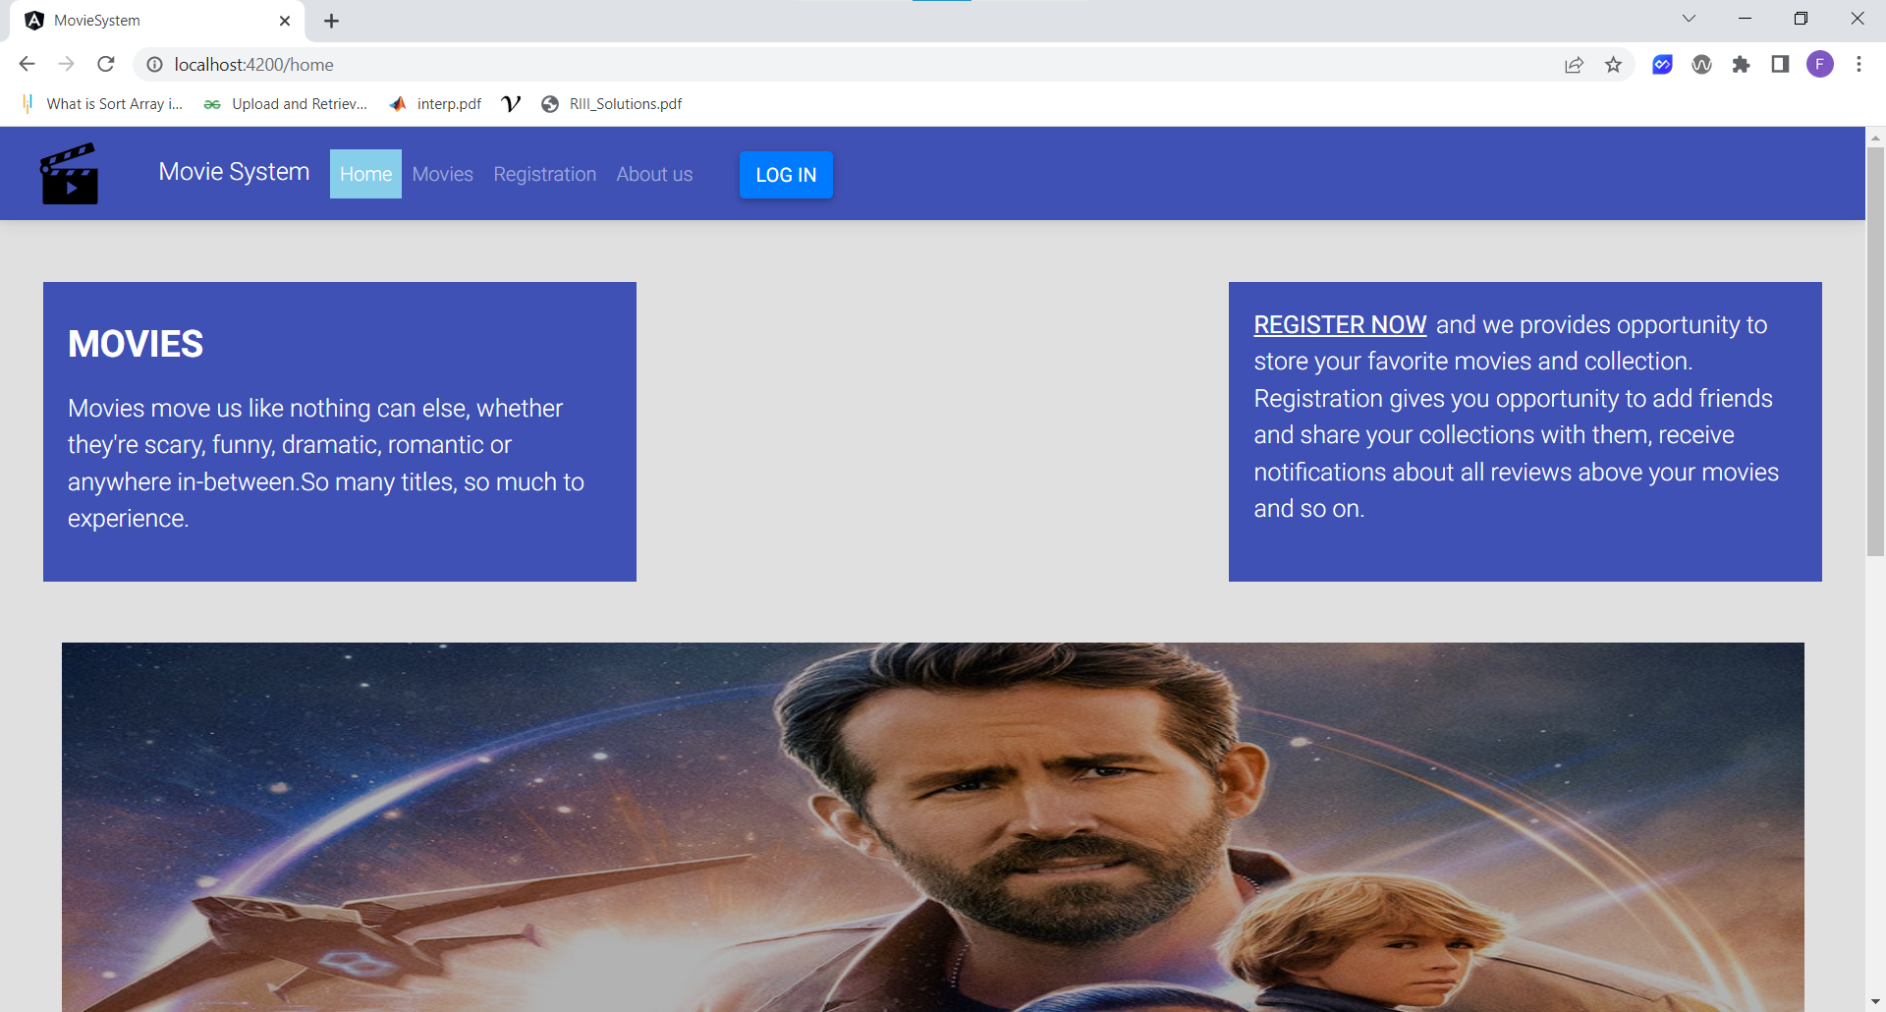

Slide 6
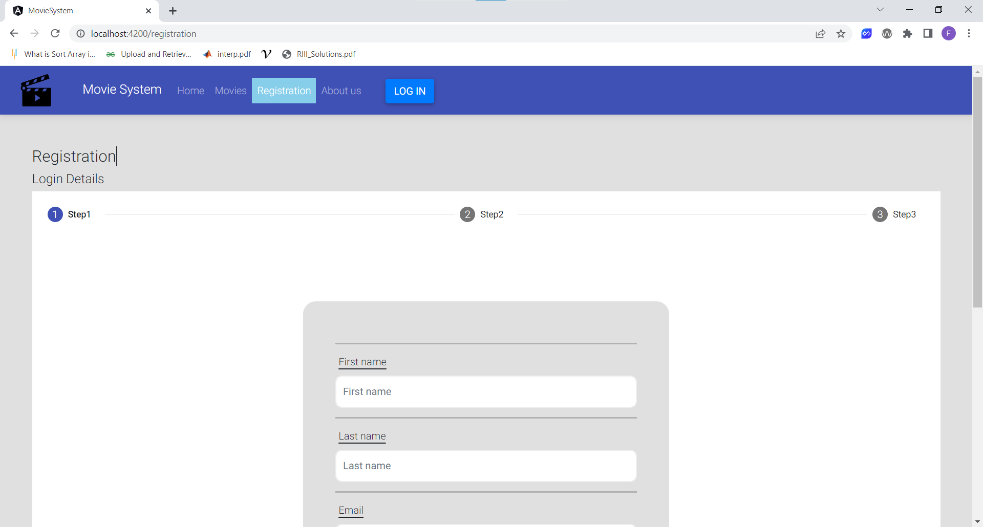

Slide 7
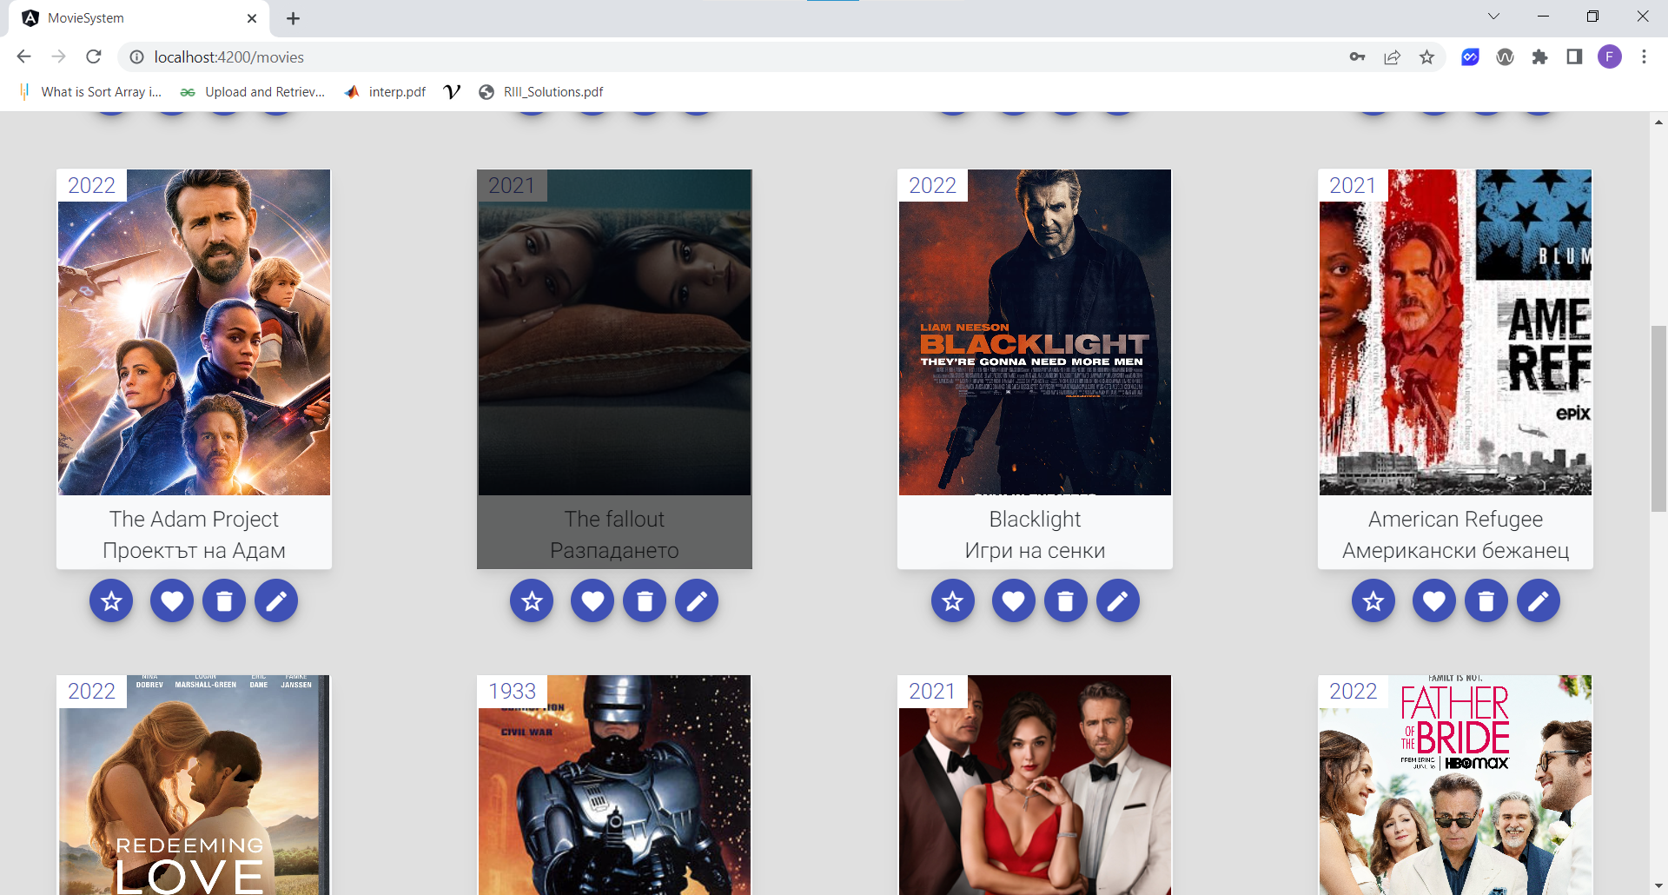

Slide 8
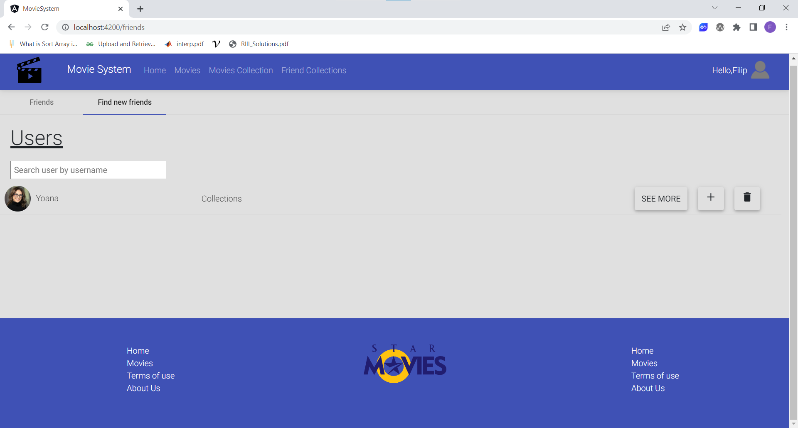

Slide 9
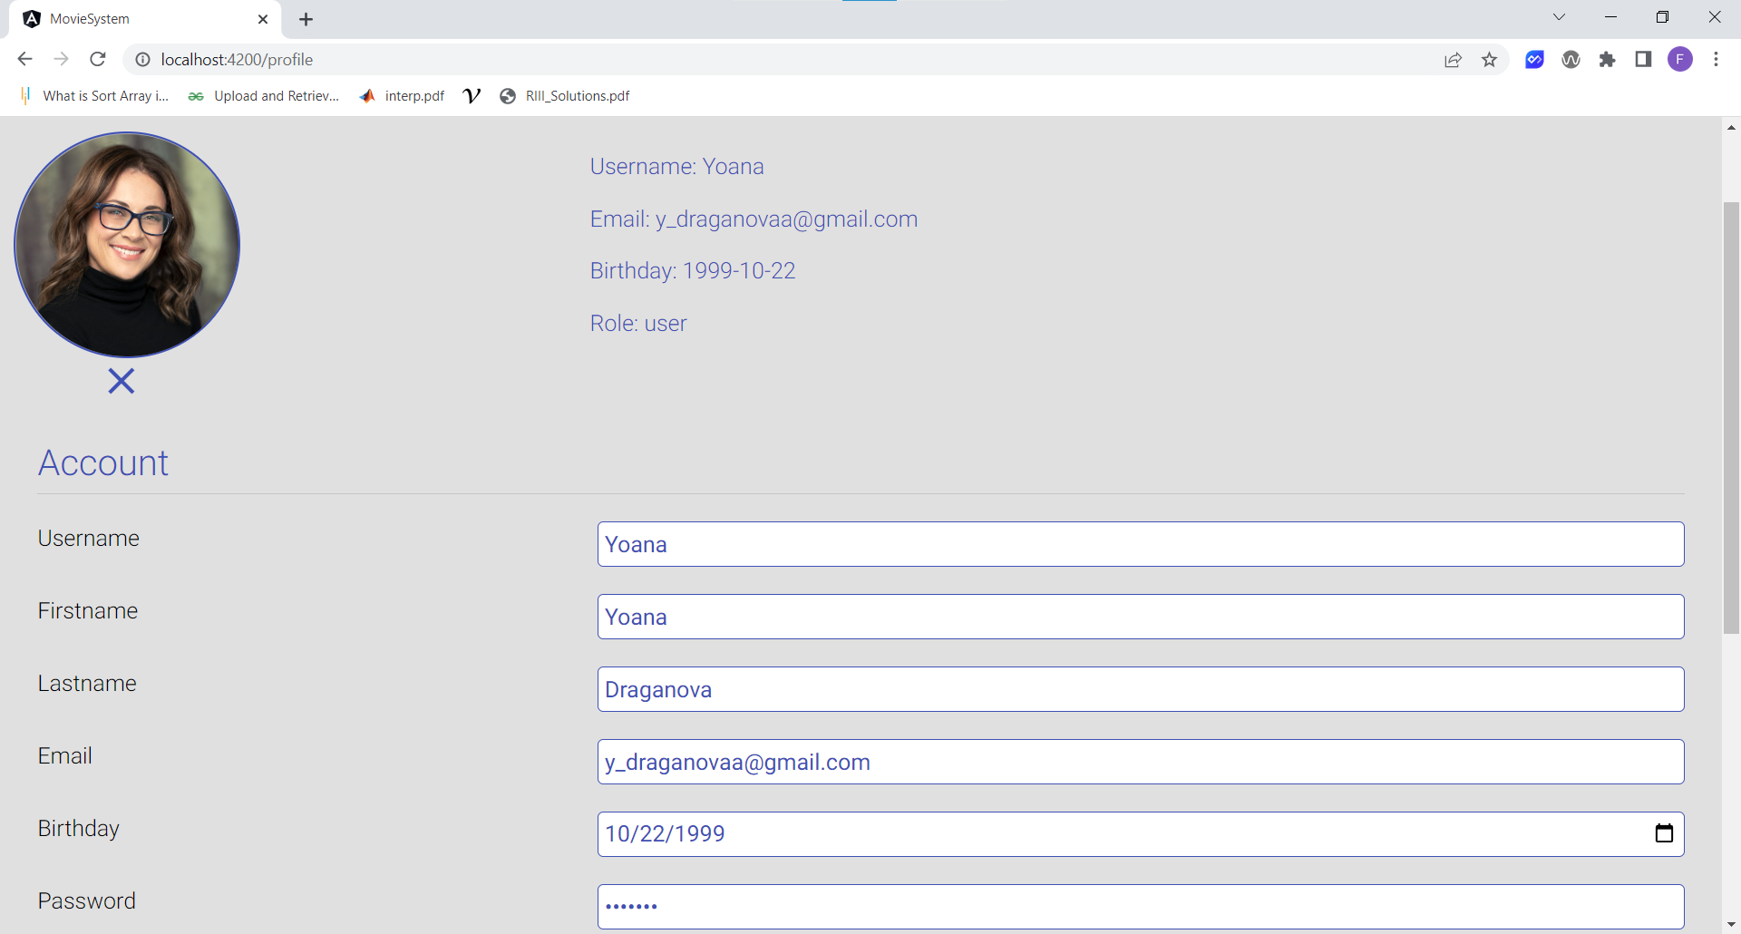

Slide 10
USED TECHONOLOGIES
1. Frontend technologies - Typescript, Angular, Angular Material and NG Bootstrap for styling, third-party libraries (@angular/youtube-player and etc.)
2. Backend technologies - JavaScript, Node JS + Express, Mongo DB, REST/JSON API

Slide 11
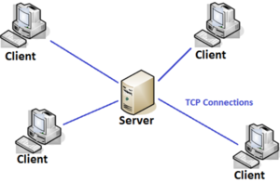
ARCHITECTURE
Single Page Application
Client-server architecture

Slide 12

Thank you for your attention!
GitHub repository: https://github.com/FilipStoyanov/Online-Movie-Review-System

